Slide 1

System Programming and Operating System
18BTIS502/18BTCS502
Compiled by –
Dr. Jyoti Malhotra & Prof. Pranav More
SPOS – subject incharge
Department of CSE
MIT School of Engineering, MIT ADT University
Pre-requisite : Maturity on Programming Languages and Data Structures
Notes:
sdfasdfasdfd

Slide 2

Course Objectives
To understand basics of System Programming.
To learn and understand data structures used in design of system software.
To understand functions of operating system.
To learn and understand process, resource and memory management.

Slide 3
Course Outcomes
Analyze and synthesize system software
Understand the working of Assemblers and Macroprocessors
Understand the functions of operating system.
Do the programming for process and thread management in OS

Slide 4
System Programming and Operating System 18BTIS502
Introduction to Systems Programming
Introduction to Macro Processors
Introduction to Operating System & Process Management
Memory Management
I/O and File Management

Slide 5
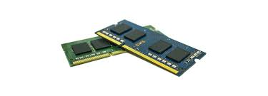
4. Memory Management
Memory Management
Memory Partitioning
Virtual Memory
Page Replacement Algorithms
Thrashing
Image courtesy: store.hp.com
Operating Systems: Internals and Design Principles, William Stallings

Slide 6


Slide 7
Memory Management (Definition)
Memory management is the process of
Allocating primary memory to user programs
Reclaiming that memory when it is no longer needed
Protecting each user’s memory area from other user programs; i.e., ensuring that each program only references memory locations that have been allocated to it.

Slide 8

Requirements
In order to manage memory effectively the OS must have
Memory allocation policies
Methods to track the status of memory locations (free or allocated)
Policies for preempting memory from one process to allocate to another

Slide 9

Memory Management Terms
Frame
A fixed length block of main memory.
Page
A fixed length block of data that resides in secondary memory.
Segment
A variable-length block of data that resides in secondary memory.
A page of data may temporarily be copied into a frame of main memory.
An entire segment may temporarily be copied into an available region of main memory
or the segment may be divided into pages which can be individually copied into main memory

Slide 10
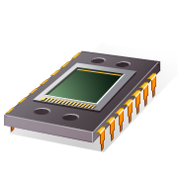
Memory Management Requirements
Memory management is intended to satisfy the following requirements:
Relocation
Protection
Sharing
Logical organization
Physical organization

Slide 11

Requirements - Relocation
Relocation is the process of adjusting program addresses to match the actual physical addresses where the program resides when it executes.
Why Relocation?
The programmer does NOT KNOW where the program will be placed in memory when it is executed,
it may be swapped to disk and return to main memory at a different location (relocated).
Memory references must be translated to the actual physical memory address.
Active processes need to be able to be swapped in and out of main memory in order to maximize processor utilization

Slide 12
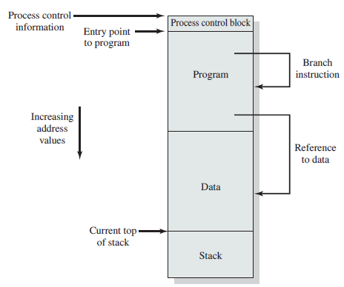
Addressing Requirements Process image, with contiguous region of main memory
contain an address of next instruction
Notes:
Assume that the process image occupies a contiguous region of main memory.
The OS needs to know the location of:
process control information
the execution stack,
the entry point to begin execution of the program for this process.
OS manages memory and is responsible for bringing this process into main memory.
The processor must deal with memory references within the program.
Data reference instructions contain the address of the byte or word of data referenced.
OS must be able to translate the memory references found in the code of the program into actual physical memory addresses, reflecting the current location of the program in main memory.

Slide 13
Requirements - Protection
A user process CANNOT access any portion of the operating system, neither program nor data.
Processes should not be able to reference memory locations of another process without permission
The processor must be able to abort such instructions at the point of execution.
Location of a program in main memory is unpredictable (relocation)
Memory references generated by a process must be checked at run time.
Notes:
All memory references generated by a process must be checked at run time to ensure that they refer only to the memory space allocated to that process.
Mechanisms that support relocation also support the protection requirement.

Slide 14

Requirements - Sharing
Allow each process access to the same copy of the program rather than have their own separate copy.
Memory management must allow controlled access to shared areas of memory without compromising protection.
Mechanisms used to support relocation support sharing capabilities
Multiple processes may use the same system file and it is natural to load one copy of the file in main memory and let it shared by those processes
Notes:
For example, multiple processes may use the same system file and it is natural to load one copy of the file in main memory and let it shared by those processes.

Slide 15
Requirements - Protection
A user process CANNOT access any portion of the operating system, neither program nor data.
Processes should not be able to reference memory locations of another process without permission
The processor must be able to abort such instructions at the point of execution.
Location of a program in main memory is unpredictable (relocation)
Memory references generated by a process must be checked at run time.
Notes:
All memory references generated by a process must be checked at run time to ensure that they refer only to the memory space allocated to that process.
Mechanisms that support relocation also support the protection requirement.

Slide 16
Requirements – Logical Organization
Logical address is generated by CPU
The logical address does not exist physically in the memory
Main memory is organized as a linear (1-D) address space consisting of a sequence of bytes or words.
Programs are written in modules
Modules can be written and compiled independently
Some are unmodifiable (read-only, execute-only)
Different degrees of protection given to modules (read-only, execute-only)
Share modules among processes

Slide 17
Requirements – Physical Organization
Two-level memory for program storage:
Disk (slow and cheap) & RAM (fast and more expensive)
Main memory is volatile, disk isn’t
User should not have to be responsible for organizing movement of code/data between the two levels.
Programmer does not know how much space will be available
overlaying allows various modules to be assigned the same region of memory but is time consuming to program

Slide 18
Memory Partitioning types
Fixed Partitioning
Dynamic Partitioning
Buddy System
Relocation
Simple Paging
Simple Segmentation
Virtual Memory Paging
Virtual Memory Segmentation

Slide 19
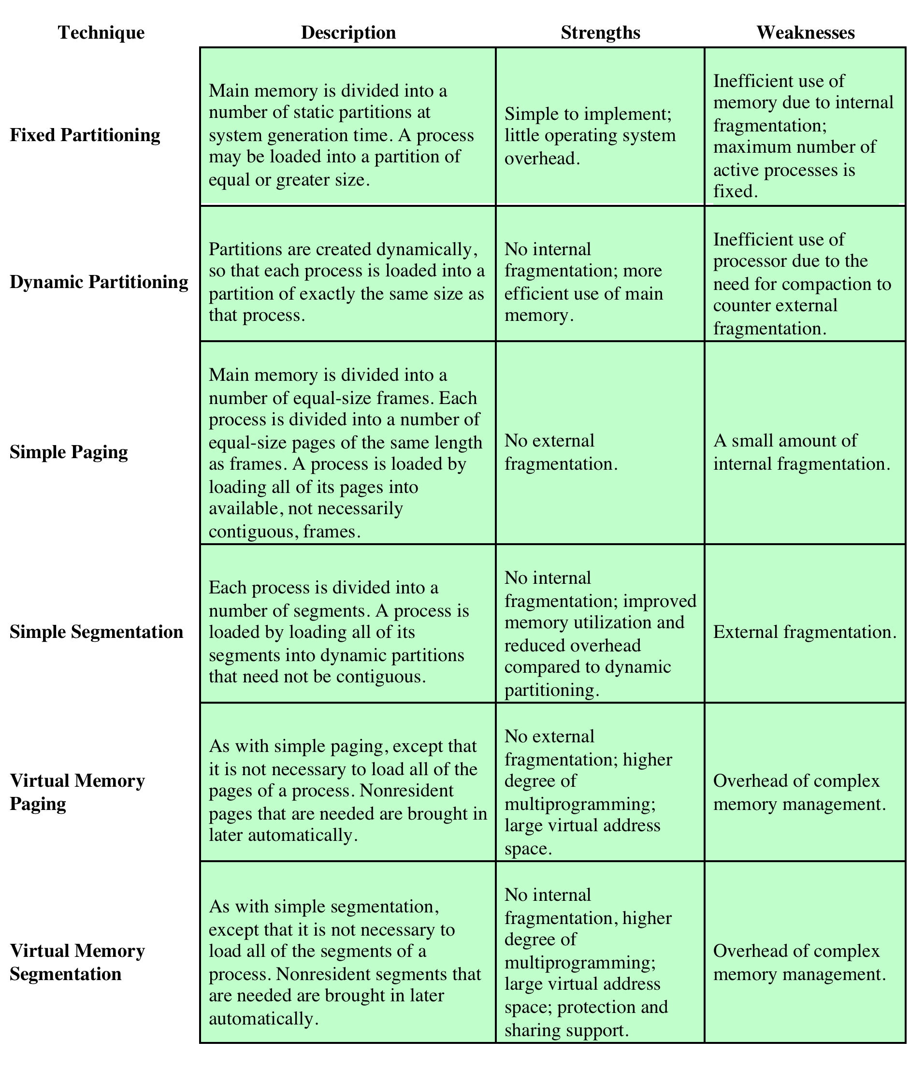
Memory Management Techniques
Notes:
Table 7.2 Memory Management Techniques

Slide 20
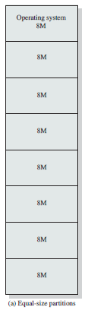
Fixed Partitioning
Equal-size partitions
Any process whose size is less than or equal to the partition size can be loaded into an available partition
The operating system can swap a process out of a partition
If partitions are full and no process is in a ready or running state
Which one to swap out? (replacement algorithms)

Slide 21
Fixed Partitioning Problems
A program may not fit in a partition.
program needs to be designed with the use of overlays
Main memory use is inefficient.
Any program, no matter how small, occupies an entire partition.
This is results in internal fragmentation.
Solution - Unequal size-partitions
Wasted space due to the block of data loaded being smaller than the partition

Slide 22
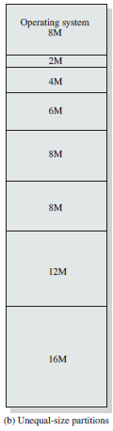
Fixed Partitioning – Unequal size partitions
Using unequal size partitions helps lessen the problems
Programs up to 16M can be accommodated without overlay.
Smaller programs can be placed in smaller partitions, reducing internal fragmentation.

Slide 23
Fixed Partitioning Problem
Small jobs will not use the space efficiently
In either fixed or variable length partition methods
The number of partitions specified at system generation time limits the number of active (not suspended) processes in the system

Slide 24
Dynamic Partitioning
Partitions are of variable length and number.
Process is allocated exactly as much memory as required.
When a process is brought into main memory, it is allocated exactly as much memory as it requires and no more.

Slide 25
Dynamic Partitioning Example
OS (8M)
External Fragmentation
Memory external to all processes is fragmented
Compaction
technique for overcoming external fragmentation
OS shifts processes so that they are contiguous
free memory is together in one block
time consuming and wastes CPU time
P1
(20M)
P2
(14M)
Empty (6M)
P2
(14M)
P4(8M)
Empty (56M)
Empty (6M)
P3
(18M)
Empty (4M)
Figure
Notes:
Animated slide
Imagine a system with 64M RAM
Initially, main memory is empty, except for the operating system
Three processes are loaded in – leaving a ‘hole’ too small for any further process
At some point, none of the processes in memory is ready. The operating system swaps out process 2,
Which leaves sufficient room to load a new process, process 4 – but that creates another hole
Later, a point is reached at which none of the processes in main memory is ready, but process 2, in the Ready-Suspend state, is available. Because there is insufficient room in memory for process 2, the operating system swaps process 1 out and swaps process 2 back in leaving yet another hole
External Fragmentation and compaction –compaction implies the capability of dynamic relocation
The difference between memory allocated and required space or memory is called Internal fragmentation. The unused spaces formed between non-contiguous memory fragments are too small to serve a new process, is called External fragmentation

Slide 26
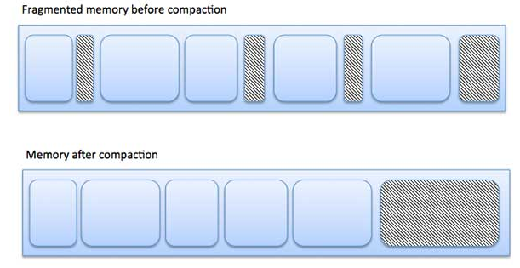

Slide 27
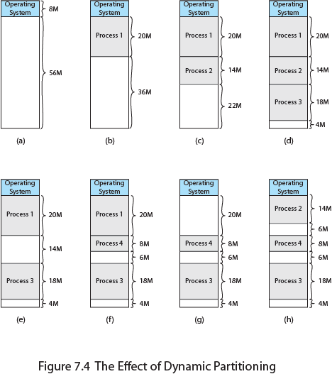
Effect of Dynamic Partitioning
Notes:
An example, using 64 Mbytes of main memory, is shown in Figure 7.4 . Initially, main memory is empty, except for the OS (a). The first three processes are loaded in, starting where the operating system ends and occupying just enough space for each process (b, c, d). This leaves a “hole” at the end of memory that is too small for a fourth process. At some point, none of
the processes in memory is ready. The operating system swaps out process 2 (e), which leaves sufficient room to load a new process, process 4 (f). Because process 4 is smaller than process 2, another small hole is created. Later, a point is reached at which none of the processes in main memory is ready, but process 2, in the Ready-Suspend state, is available. Because there is insufficient room in memory for process 2, the operating system swaps process 1 out (g) and swaps process 2 back in (h).
As this example shows, this method starts out well, but eventually it leads to a situation in which there are a lot of small holes in memory. As time goes on, memory becomes more and more fragmented, and memory utilization declines. This phenomenon is referred to as external fragmentation , indicating that the memory that is external to all partitions becomes increasingly fragmented. This is in contrast to internal fragmentation, referred to earlier.

Slide 28
Placement Algorithms
As memory compaction is time consuming, the OS must be clever in deciding how to assign processes to memory.
Best-fit
Chooses the block that is closest in size to the request
First-fit
Scans memory from the beginning and chooses the first available block that is large enough
Next-fit
Scans memory from the location of the last placement
Worst performer overall
Since smallest block is found for process, the smallest amount of fragmentation is left
More often allocate a block of memory at the end of memory where the largest block is found.
Notes:
PLACEMENT ALGORITHM Because memory compaction is time consuming, the OS designer must be clever in deciding how to assign processes to memory. When it is time to load or swap a process into main memory, and if there is more than one free block of memory of sufficient size, then the operating system must decide which free block to allocate.
Three placement algorithms that might be considered are best-fit, first-fit, and next-fit. All, of course, are limited to choosing among free blocks of main memory that are equal to or larger than the process to be brought in. Best-fit chooses the block that is closest in size to the request. First-fit begins to scan memory from the beginning and chooses the first available block that is large enough. Next-fit begins to scan memory from the location of the last placement, and chooses the next available block that is large enough.

Slide 29
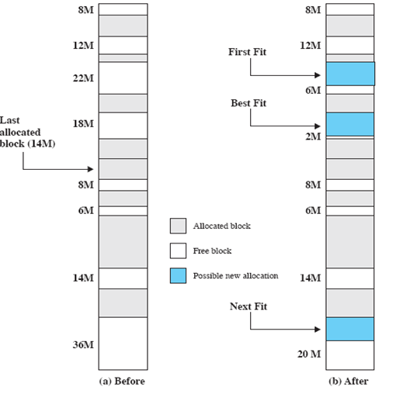
16-MB allocation request
Notes:
Slide shows Fig - an example memory configuration after a number of placement and swapping-out operations.
The last block that was used was a 22-Mbyte block from which a 14-Mbyte partition was created.
Figure b shows the difference between the best, first, and next-fit placement algorithms in satisfying a 16-Mbyte allocation request.
Best-fit will search the entire list of available blocks and make use of the 18-Mbyte block, leaving a 2-Mbyte fragment.
First-fit results in a 6-Mbyte fragment, and
Next-fit results in a 20-Mbyte fragment.

Slide 30
Fixed Vs Dynamic partitioning
Technique | Description | Strengths | Weaknesses
Fixed Partitioning | Main Memory is divided into several static partitions. A process may be loaded into a partition of equal or greater size. | Simple to implement. Little OS overhead | Inefficient use of memory due to internal fragmentation.
Dynamic Partitioning | Partitions are created dynamically. Each process is loaded into a partition of the same size as that process. | No internal fragmentation; More efficient use of Main Memory | Inefficient use of processor due to external fragmentation and need for compaction.

Slide 31
Buddy System
Comprised of fixed and dynamic partitioning schemes
The buddy memory allocation technique divides memory into partitions to fulfil possible memory request(s) - manages memory in power of two increments.
The memory will be allocated from lower to higher blocks
This system makes use of splitting memory into halves to try to give a best fit.
Assume the memory size is 2^{U}, suppose a size of S is required.
If 2^{U-1}<S<=2^{U}: Allocate the whole block
Else: Recursively divide the block equally and test the condition at each time, when it satisfies, allocate the block and get out the loop. [i.e. split into two equal buddies of size 2^{U –1} ]
256 KB
2^{U} = 2⁸ = 256 i.e. U = 8
Request is of size say 200 KB
i.e. 2⁷ < 200 ≤ 2⁸
128 < 200 ≤ 256 TRUE; Allocate the whole block
2^{U} = 2⁸ = 256 i.e. U = 8
Request is of size say 120 KB
i.e. 2⁷ < 120 ≤ 2⁸
128 < 120 ≤ 256 FALSE; Split the block into 2 equal buddies of size 2^{U-1} i.e. 2⁷ i.e. 128 KB
Notes:
In a fixed partitioning scheme limits the number of active processes and may use space inefficiently if there is a poor match between available partition sizes and process sizes.
A dynamic partitioning scheme is more complex to maintain and includes the overhead of compaction.
An interesting compromise is the buddy system.
The Linux kernel also uses the buddy system, with further modifications to minimise external fragmentation, along with various other allocators to manage the memory within blocks.

Slide 32
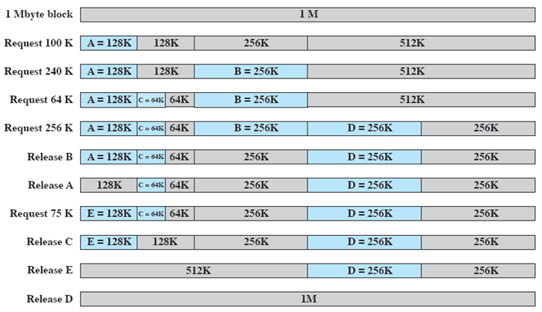
Example of Buddy System
Notes:
Figure gives an example using a 1-Mbyte initial block.
The first request,A, is for 100 Kbytes, for which a 128K block is needed.
The initial block is divided into two 512K buddies.
The first of these is divided into two 256K buddies,
and the first of these is divided into two 128K buddies,
one of which is allocated to A.
The next request,B, requires a 256K block. Such a block is already available and is allocated.
The process continues with splitting and coalescing occurring as needed.
Note that when E is released,two 128K buddies are coalesced into a 256K block, which is immediately coalesced with its buddy

Slide 33
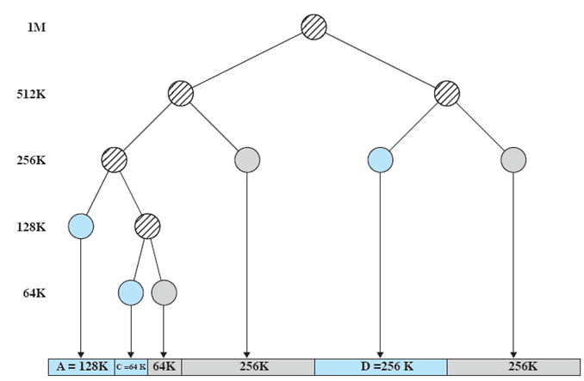
Tree Representation of Buddy System
Notes:
Figure shows a binary tree representation of the buddy allocation immediately after the Release B request.
The leaf nodes represent the current partitioning the memory.
If two buddies are leaf nodes, then at least one must be allocated;
otherwise they would be coalesced into a larger block.
The buddy system is a reasonable compromise to overcome the disadvantages of both the fixed and variable partitioning schemes,
But in contemporary operating systems, virtual memory based on paging and segmentation is superior.
However, the buddy system has found application in parallel systems as an efficient means of allocation and release for parallel programs.

Slide 34
Buddy System : Advantages and Disadvantages
Advantages
Easy to implement a buddy system
Allocates block of correct size
It is easy to merge adjacent holes
Fast to allocate memory and de-allocating memory
Dis-advantages
It requires all allocation unit to be powers of 2
It may lead to internal fragmentation.

Slide 35
Relocation
Several types of addresses:
With memory compaction; processes are shifted while they are in main memory.
The locations referenced by a process are not fixed; they changes each time a process is swapped in or shifted.
Logical
reference to a memory location independent of the current assignment of data to memory
Relative
address is expressed as a location relative to some known point (value in a process register)
Physical or Absolute
Actual location in main memory
Notes:
A logical address is a reference to a memory location independent of the current assignment of data to memory; a translation must be made to a physical address before the memory access can be achieved.
A relative address is a particular example of logical address, in which the address is expressed as a location relative to some known point, usually a value in a processor register.
A physical address , or absolute address, is an actual location in main memory.

Slide 36
Paging
Partition memory into equal fixed-size chunks that are relatively small.
Divide each process into the same size chunks
Pages
The chunks of a process
Frames
The chunks of memory
Pages , could be assigned to frames , or page frames
Page size = Frame size
Convenient paging scheme : Page size and frame size must be power of 2
Page address is called logical address = Page Number + Page offset
Frame address is called physical address = Frame Number + Page offset
Notes:
The chunks of a process, known as pages , could be assigned to available chunks of memory, known as frames , or page frames.
The wasted space in memory for each process is due to internal fragmentation consisting of only a fraction of the last page of a process.
There is no external fragmentation.

Slide 37
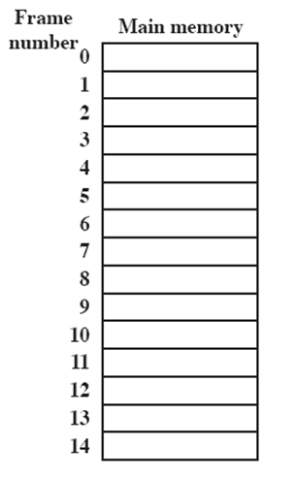
Processes and Frames
Scenario :
1. Load process A
2. Load process B
3. Load process C
4. Suspend process B
5. Load process D
A.0
A.1
A.2
A.3
B.0
D.0
B.1
D.1
B.2
D.2
Process
A - 4 pages
B – 3 pages
C – 4 pages
D – 5 pages
C.0
C.1
C.2
C.3
D.3
D.4
Notes:
Animated slide
System with a number of frames allocated
Process A, stored on disk, consists of four pages. When it comes time to load this process, the operating system finds four free frames and loads the four pages of process A into the four frames.
Process B, consisting of three pages, and process C, consisting of four pages, are subsequently loaded.
Then process B is suspended and is swapped out of main memory.
Later, all of the processes in main memory are blocked, and the operating system needs to bring in a new process, process D, which consists of five pages. The Operating System loads the pages into the available frames and updates the page table

Slide 38
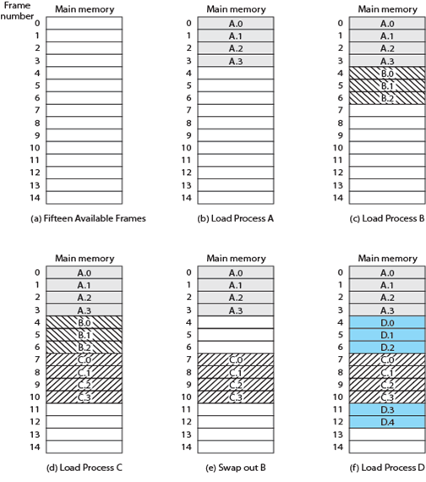
Assignment of Process to Free Frames
Notes:
Figure illustrates the use of pages and frames. At a given point in time, some of the frames in memory are in use and some are free. A list of free frames is maintained by the OS. Process A, stored on disk, consists of four pages. When it is time to load this process, the OS finds four free frames and loads the four pages of process A into the four frames ( Figure b ). Process B, consisting of three pages, and process C, consisting of four pages, are subsequently loaded. Then process B is suspended and is swapped out of main memory. Later, all the processes in main memory are blocked, and the OS needs to bring in a new process, process D, which consists of five pages.
Now suppose, as in this example, that there are not sufficient unused contiguous frames to hold the process. Does this prevent the operating system from loading D? The answer is no, because we can once again use the concept of logical address.

Slide 39
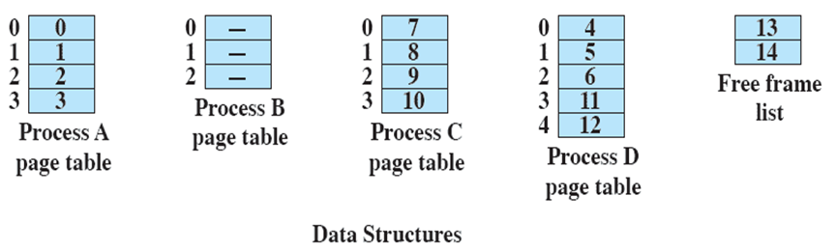
Page Table
Maintained by OS for each process
Contains the frame location for each page in the process
Processor must know how to access the page table for the current process
Used by processor to produce a physical address
Memory address consist of a page number and offset within the page
Notes:
Continuing our example, the five pages of process D are loaded into frames 4, 5, 6, 11, and 12. Figure shows the various page tables at this time. A page table contains one entry for each page of the process, so that the table is easily indexed by the page number (starting at page 0 ). Each page table entry contains the number of the frame in main memory, if any, that holds the corresponding page. In addition, the OS maintains a single free-frame list of all the frames in main memory that are currently unoccupied and available for pages.
Thus we see that simple paging, as described here, is like fixed partitioning. The differences are that, with paging, the partitions are rather small; a program may occupy more than one partition; and these partitions need not be contiguous.

Slide 40
Example of logical address, paging, and segmentation
Address – 16 bits
Page size 1K i.e. 1024 bytes
(offset field-10 bits + 6 bits for page number)
The relative address 1502, in binary form, is 0000010111011110
Thus a program can consist of a maximum of
2⁶ =64 pages of 1K bytes each.
Notes:
In this example, 16-bit addresses are used, and the page size is 1K =1024 bytes.
The relative address 1502, in binary form, is 0000010111011110.
With a page size of 1K, an offset field of 10 bits is needed, leaving 6 bits for the page number.
Thus a program can consist of a maximum of 2⁶ =64 pages of 1K bytes each.

Slide 41
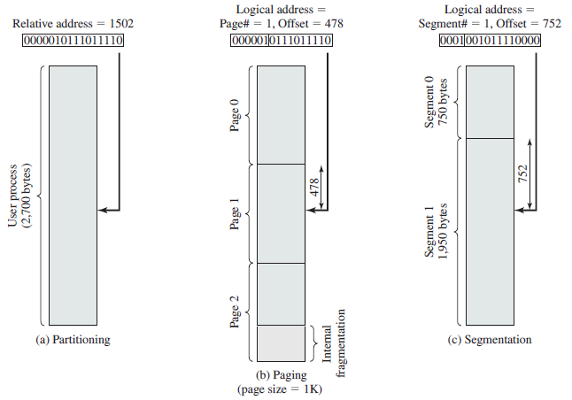
Logical Addresses
Notes:
As Figure (b) shows, relative address 1502 corresponds to
an offset of 478 (0111011110) on page 1 (000001),
which yields the same 16-bit number, 0000010111011110.
Consider an address of n + m bits, where the leftmost n bits are the segment number and the rightmost m bits
are the offset.
In the example on the slide
n = 4 and
m =12.
Thus the maximum segment size is 2¹² = 4096.
The following steps are needed for address translation:
• Extract the segment number as the leftmost n bits of the logical address.
• Use the segment number as an index into the process segment table to find the starting physical address of the segment.
Compare the offset, expressed in the rightmost m bits, to the length of the segment. If the offset is greater than or equal to the length, the address is invalid.
The desired physical address is the sum of the starting physical address of the segment plus the offset.

Slide 42
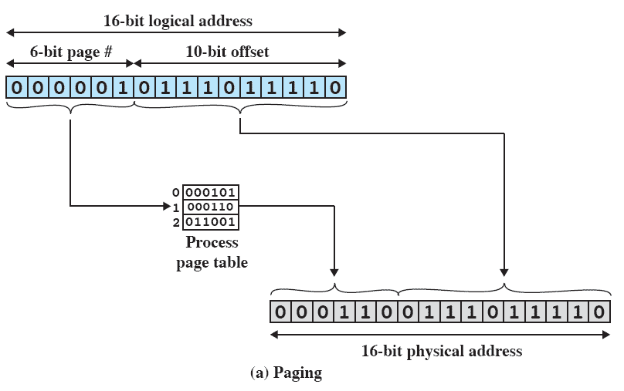
Logical-to-Physical Address Translation - Paging
Page is residing in main memory frame 6 = binary 000110
frame number 6, offset 478
Notes:
In our example, we have the logical address 0000010111011110, which is page number 1, offset 478. Suppose that this page is residing in main memory frame 6 binary 000110. Then the physical address is frame number 6, offset 478 0001100111011110 ( Figure 7.12a ).

Slide 43
Segmentation
The difference with dynamic partitioning, is that with segmentation a program may occupy more than one partition, and these partitions need not be contiguous.
A program can be subdivided into segments
Segments may vary in length
There is a maximum segment length
Addressing consist of two parts
< segment #, offset>
Segmentation is like dynamic partitioning
Process Segment table:
Base Address: It contains the starting physical address where the segments reside in memory.
Limit: It specifies the length of the segment.
Segmentation eliminates internal fragmentation but suffers from little external fragmentation
Notes:
Segmentation scheme would make use of a segment table for each process and a list of free blocks of main memory. Each segment table entry would have to give
the starting address in main memory of the corresponding segment.
the length of the segment, to assure that invalid addresses are not used.
When a process enters the Running state, the address of its segment table is loaded into a special register used by the memory management hardware.
A user program can be subdivided using segmentation, in which the program and its associated data are divided into a number of segments . It is not required that all segments of all programs be of the same length, although there is a maximum segment length. As with paging, a logical address using segmentation consists of two parts, in this case a segment number and an offset.
Because of the use of unequal-size segments, segmentation is like dynamic partitioning. In the absence of an overlay scheme or the use of virtual
memory, it would be required that all a program’s segments be loaded into memory for execution. Segmentation eliminates internal fragmentation but, like dynamic partitioning, it suffers from external fragmentation. However, because a process is broken up into several smaller pieces, the external fragmentation should be less.

Slide 44
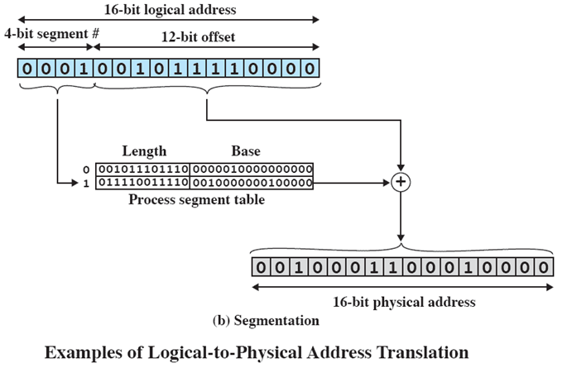
Logical-to-Physical Address Translation - Segmentation
0000001011110000
0010000000100000
Notes:
In our example, we have the logical address 0001001011110000, which is segment number 1, offset 752.
Suppose that this segment is residing in main memory starting at physical address 0010000000100000.
Then the physical address is 0010000000100000 + 001011110000 = 0010001100010000

Slide 45
Real and Virtual Memory
Real memory
main memory, the actual RAM
Virtual memory
memory on disk
allows for effective multiprogramming and relieves the user of tight constraints of main memory
Virtual memory: Storage allocation scheme in which secondary memory is addressed as though it were a part of main memory.

Slide 46
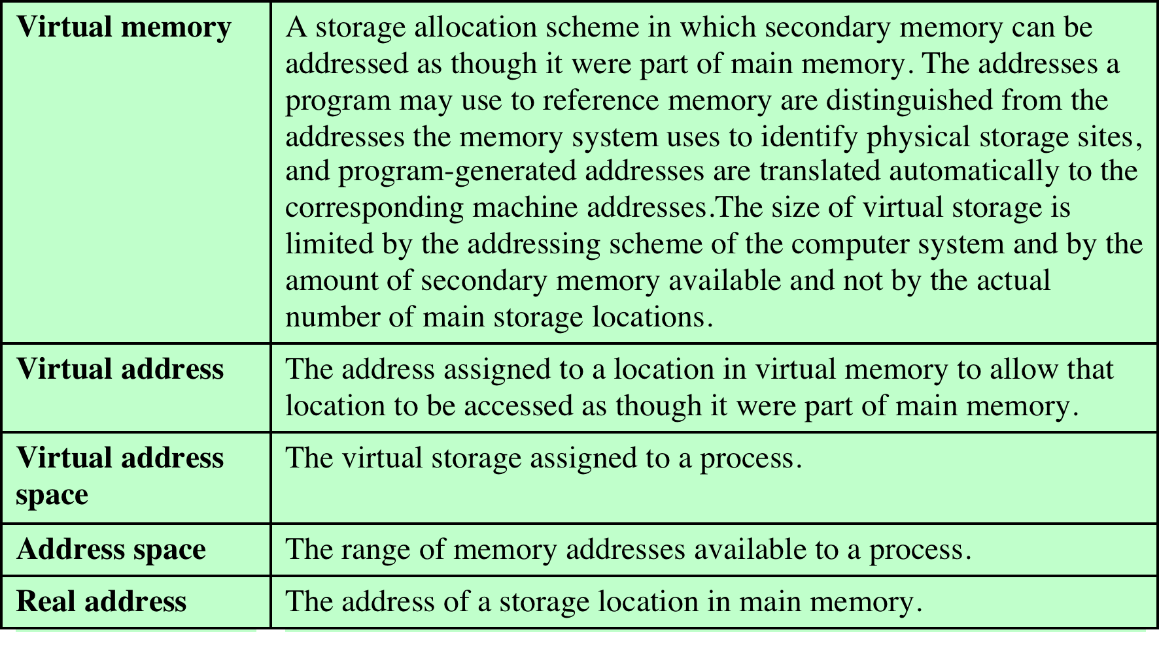
Virtual Memory Terminology
Notes:
Some key terms related to virtual memory.

Slide 47
Thrashing
A process that is spending more time paging than executing is said to be thrashing.
The process doesn't have enough frames to hold all the pages for its execution, so it is swapping pages in and out very frequently to keep executing
A state in which the system spends most of its time swapping process pieces rather than executing instructions
To avoid this, the operating system tries to guess, based on recent history, which pieces are least likely to be used in the near future
Notes:
In the steady state, practically all of main memory will be occupied with process pieces, so that the processor and operating system have direct access to as many processes as possible.
Thus, when the operating system brings one piece in, it must throw another out.
If it throws out a piece just before it is used, then it will just have to go get that piece again almost immediately.
Too much of this leads to a condition known as thrashing
The system spends most of its time swapping pieces rather than executing instructions.
Avoidance of thrashing - OS tries to guess, based on recent history, which pieces are least likely to be used in the near future.

Slide 48
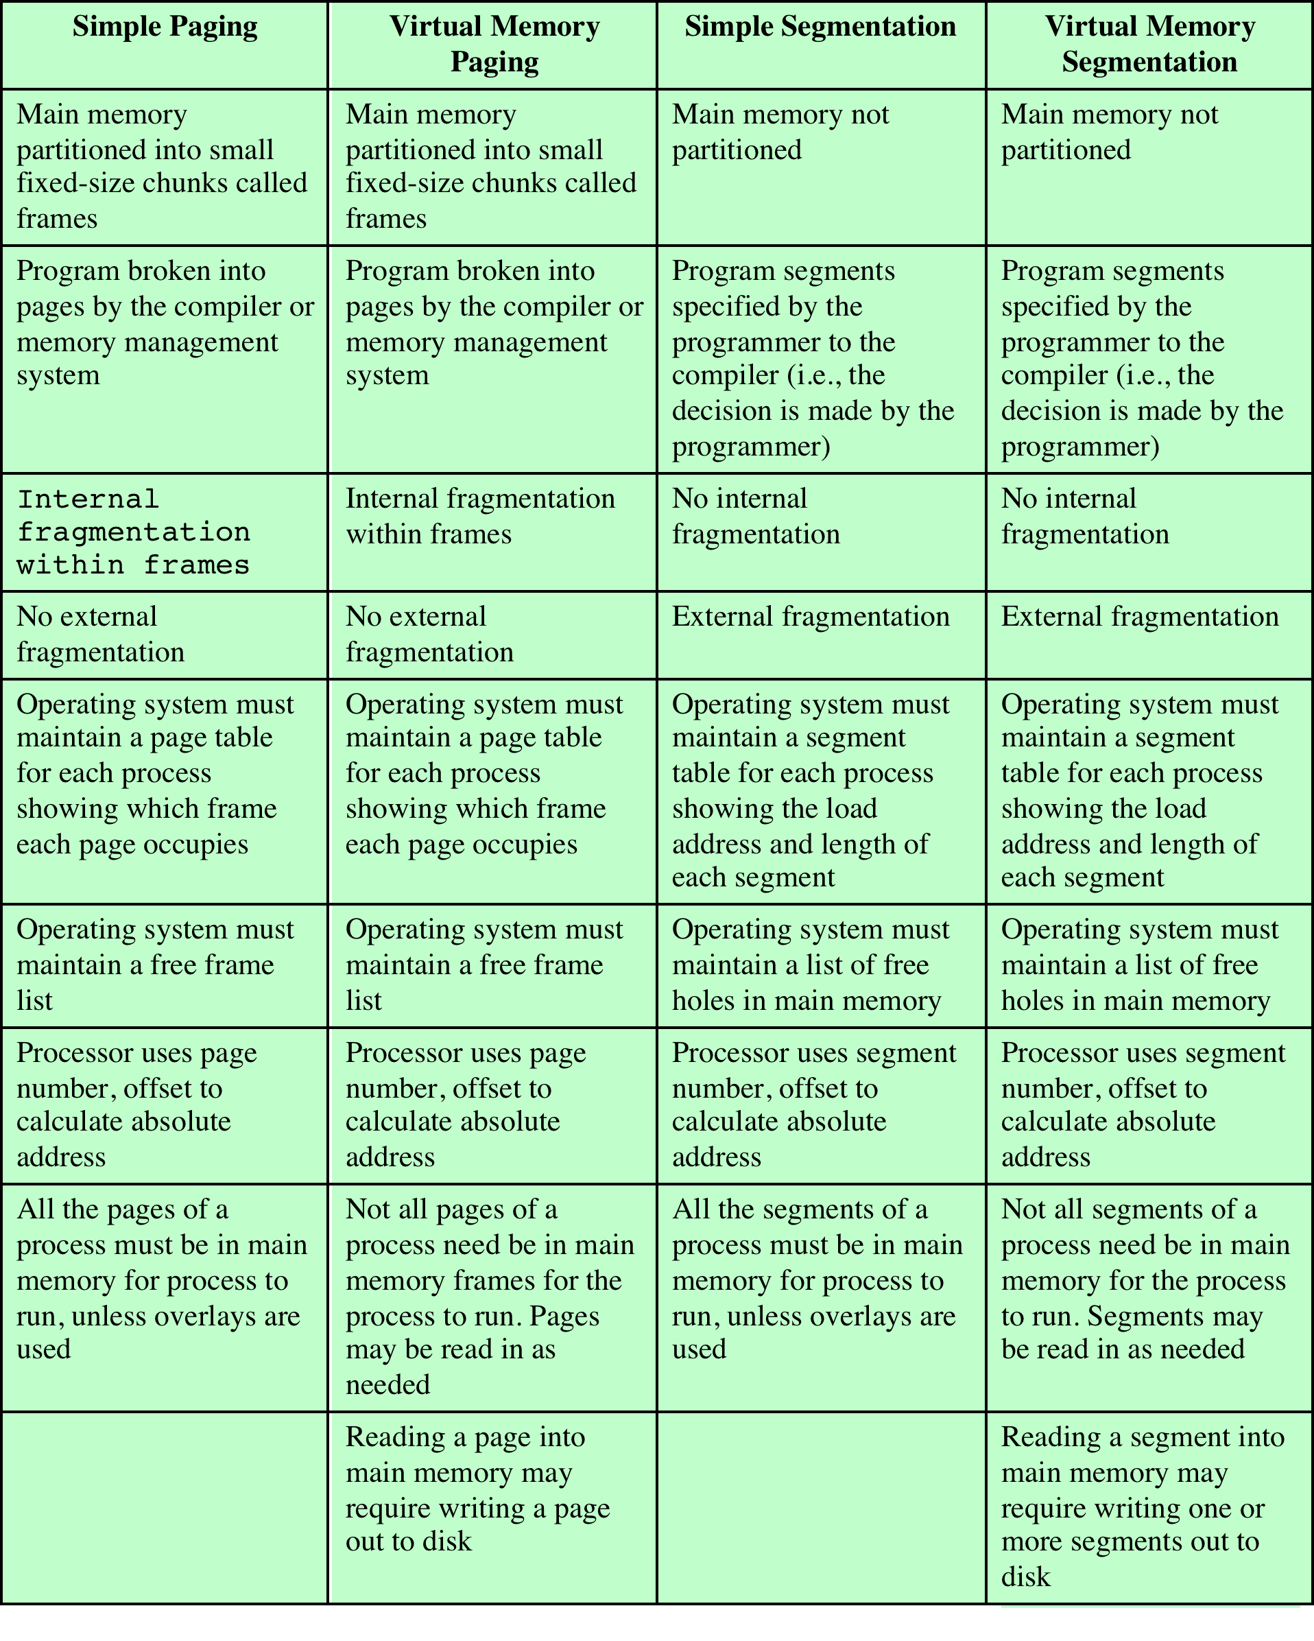
Characteristics of Paging and Segmentation
Notes:
Table summarizes characteristics of paging and segmentation, with and without the use of virtual memory.

Slide 49
Paging
The term virtual memory is usually associated with systems that employ paging
Use of paging to achieve virtual memory was first reported for the Atlas computer.
Each process has its own page table
each page table entry contains the frame number of the corresponding page in main memory
Entry k contains the frame # of page k (if page k is in memory)
Notes:
The term virtual memory is usually associated with systems that employ paging, although virtual memory based on segmentation is also used.
The use of paging to achieve virtual memory was first reported for the Atlas computer
Each process has its own page table, and when all of its pages are loaded into main memory, the page table for a process is created and loaded into main memory.
Each page table entry (PTE) contains the frame number of the corresponding page in main memory.
A page table is also needed for a virtual memory scheme based on paging.

Slide 50
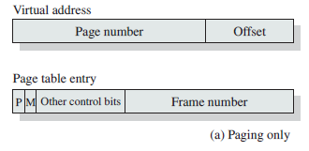
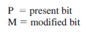
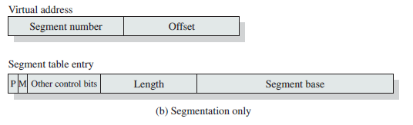
Memory Management Formats
M bit indicates whether the contents of the corresponding page have been altered since the page was last loaded into main memory.
Notes:
Again, it is typical to associate a unique page table with each process. In this case, however,
the page table entries become more complex ( Figure a ). Because only some of
the pages of a process may be in main memory, a bit is needed in each page table
entry to indicate whether the corresponding page is present (P) in main memory or
not. If the bit indicates that the page is in memory, then the entry also includes the
frame number of that page.
The page table entry includes a modify (M) bit, indicating whether the contents
of the corresponding page have been altered since the page was last loaded
into main memory. If there has been no change, then it is not necessary to write the
page out when it comes time to replace the page in the frame that it currently occupies.
Other control bits may also be present. For example, if protection or sharing is
managed at the page level, then bits for that purpose will be required.

Slide 51

Principle of Locality
Program and data references within a process tend to cluster.
Only a few pieces of a process will be needed over a short period of time.
Therefore it is possible to make intelligent guesses about which pieces will be needed in the future.
This suggests that virtual memory may work efficiently.
Notes:
The principle of locality states that program and data references within a process tend to cluster.
Hence, the assumption that only a few pieces of a process will be needed over a short period of time is valid.
Also, it should be possible to make intelligent guesses about which pieces of a process will be needed in the near future, which avoids
thrashing.
One way to confirm the principle of locality is to look at the performance of processes in a virtual memory environment.

Slide 52
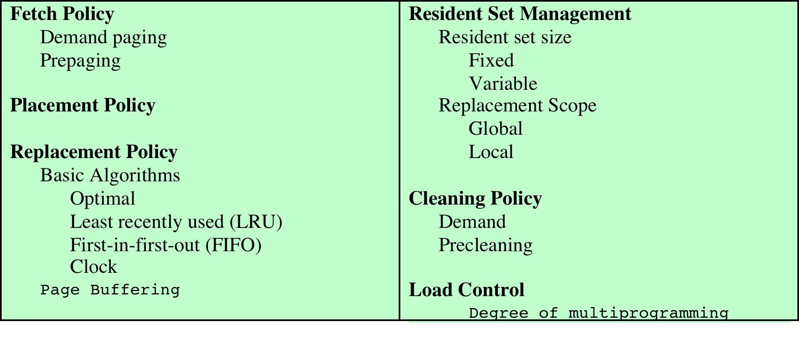
Policies for Virtual Memory
Key issue: Performance
minimize page faults
Page Fault in OS occurs when the page referenced by the CPU is not found in main memory.

Slide 53
Unit 4 – Memory Management
Memory Management
Memory Partitioning
Fixed
Dynamic
Buddy
Paging and Segmentation
Page placement strategies : First fit, Next fit, Best fit
Virtual Memory
Thrashing
Principle of Locality
Demand Paging
Page replacement policies
FIFO, LRU, Optimal, Clock
Translation Look-aside buffer

Slide 54

Fetch Policy
Determines when a page should be brought into memory
Two main types:
Demand Paging
Prepaging
Notes:
The fetch policy determines when a page should be brought into main memory. The two common alternatives are demand paging and prepaging.

Slide 55
Demand Paging and Pre-paging
Demand Paging
A page is brought into main memory only when a reference is made to a location on that page
Many page faults when process first started
As more and more pages are brought in, the principle of locality suggests that most future references will be to pages that have recently been brought in.
This drops the number of page faults.
Pre Paging
Brings in more pages than needed
More efficient to bring in pages that reside contiguously on the disk
Ineffective if most of the extra pages that are brought in are not referenced
Notes:
With demand paging,
A page is brought into main memory only when a reference is made to a location on that page.
When a process is first started, there will be a flurry of page faults.
As more and more pages are brought in, the principle of locality suggests that most future references will be to pages that have recently been brought in.
Thus, after a time, matters should settle down and the number of page faults should drop to a very low level.
With prepaging,
Pages other than the one demanded by a page fault are brought in.
If the pages of a process are stored contiguously in secondary memory, then it is more efficient to bring in a number of contiguous pages at one time rather than bringing them in one at a time over an extended period.
Of course, this policy is ineffective if most of the extra pages that are brought in are not referenced.
The prepaging policy could be employed either when a process first starts up, in which case the programmer would somehow have to designate desired pages, or every time a page fault occurs.
The latter would seem preferable because it is invisible to the programmer.
However, the utility of prepaging has not been established.
Prepaging should not be confused with swapping.
When a process is swapped out of memory and put in a suspended state, all of its resident pages are moved out.
When the process is resumed, all of the pages that were previously in main memory are returned to main memory.

Slide 56

Page Replacement Algorithms
There are certain basic algorithms that are used for the selection of a page to replace.
Objective is that the page that is removed be the page least likely to be referenced soon.
Algorithms:
First-in-first-out (FIFO)
Optimal
Least recently used (LRU)
Clock
Page Fault - No page in the frame
OR
Page fault occurring after the frame allocation is initially filled

Slide 57
FIFO Page Replacement
A very simple way of Page replacement is FIFO (First in First Out)
Treats page frames allocated to a process as a circular buffer
Page that has been in memory the longest is replaced
A page fetched into memory a long time ago may have now fallen out of use.
Not feasible; There can be pages that are heavily used throughout the life of a program.
Those pages will be repeatedly paged in and out by the FIFO algorithm.

Slide 58
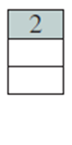
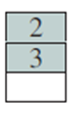
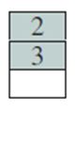
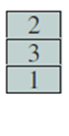
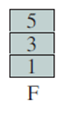
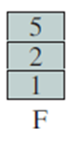
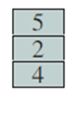
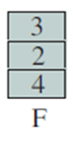
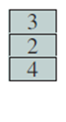
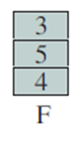
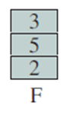
Example
An example of the implementation of these policies will use a page address stream formed by executing the program is
2 3 2 1 5 2 4 5 3 2 5 2
Which means that the first page referenced is 2, the second page referenced is 3 and so on.
Frames - 3
Page Hit – Already in the MM
Page Fault – Page absent in the frame (target is minimize PF)
FIFO:
Time 1 2 3 4 5 6 7 8 9 10 11 12
The FIFO policy results in six-page faults

Slide 59
LRU – Least Recently Used
Replaces the page in the memory that has not been referenced for the longest time
By the principle of locality, this should be the page least likely to be referenced soon.
Difficult to implement
One approach is to tag each page with the time of last reference.
This requires a great deal of overhead.
Notes:
LRU policy does nearly as well as the optimal policy.

Slide 60
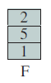
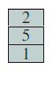
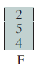
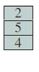
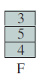
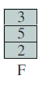
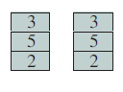
Example
An example of the implementation of these policies will use a page address stream formed by executing the program is
2 3 2 1 5 2 4 5 3 2 5 2
Which means that the first page referenced is 2, the second page referenced is 3 and so on.
Frames - 3
LRU:
Time 1 2 3 4 5 6 7 8 9 10 11 12
Page string
The LRU policy results in four-page faults; better than FIFO, not as well as optimal policy

Slide 61
Optimal Replacement Policy
Selects for replacement that page for which the time to the next reference is the longest
This policy results in the fewest number of page faults
Difficult to implement
it would require the operating system to have perfect knowledge of future events.
Notes:
This policy is impossible to implement, because it would require the operating system to have perfect knowledge of future events

Slide 62
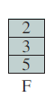
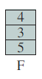
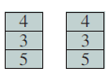
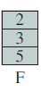
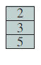
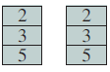
Example
An example of the implementation of these policies will use a page address stream formed by executing the program is
2 3 2 1 5 2 4 5 3 2 5 2
Frames - 3
OPTIMAL:
Time 1 2 3 4 5 6 7 8 9 10 11 12
Page string
The Optimal page replacement policy results in three-page faults

Slide 63
Clock Policy (Second chance algorithm)
A variant of FIFO.
Uses an additional bit called a “use bit”/”reference bit”
When a page is first loaded in memory, the use bit is set to 0
When a page is referenced(i.e. page hit), the use bit is set to 1
When it is time to replace a page, the OS scans the set in FIFO flipping all 1’s to 0
The first frame encountered with the use bit already set to 0 is replaced.
This policy is similar to FIFO, except that, in the clock policy, any frame with a use bit of 1 is passed over by the algorithm.

Slide 64
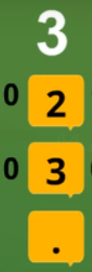

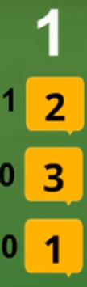
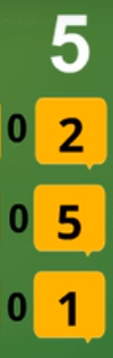






Example
An example of the implementation of these policies will use a page address stream formed by executing the program is
2 3 2 1 5 2 4 5 3 2 5 2
Frames - 3
CLOCK:
Time 1 2 3 4 5 6 7 8 9 10 11 12
Page string
Notes:
https://www.youtube.com/watch?v=WNLVnss_3xg

Slide 65

Comparison
Experiment with frame allocations of 6, 8, 10, 12, and 14 frames
Notes:
Figure shows the results of an experiment reported in, which compares the four algorithms that we have been discussing;
It is assumed that the number of page frames assigned to a process is fixed.
Ran the experiment with frame allocations of 6, 8, 10, 12, and 14 frames.
The differences among the four policies are most striking at small allocations, with FIFO being over a factor of 2 worse than optimal.

Slide 66
Virtual Memory Problems
Occupy
Page tables can occupy large amounts of memory – (memory is accessed twice – 1 for page number; other for frame number)
Address
Address translation using page tables increases execution time
Cache
Cache : Translation Lookaside Buffer (TLB)
Place frame numbers in TLB
CPU → Logical Address → TLB → Physical address

Slide 67
Translation Lookaside Buffer (TLB)
Each virtual memory reference can cause two physical memory accesses:
one to fetch the page table entry
one to fetch the next instruction
To overcome the effect of doubling the memory access time, most virtual memory schemes make use of a special high-speed cache called a translation lookaside buffer
Notes:
TRANSLATION LOOKASIDE BUFFER In principle, every virtual memory reference
can cause two physical memory accesses: one to fetch the appropriate page table
entry and one to fetch the desired data. Thus, a straightforward virtual memory
scheme would have the effect of doubling the memory access time. To overcome
this problem, most virtual memory schemes make use of a special high-speed cache
for page table entries, usually called a translation lookaside buffer (TLB) . This
cache functions in the same way as a memory cache (see Chapter 1 ) and contains
those page table entries that have been most recently used.

Slide 68

Use of a TLB
Notes:
The organization of the resulting paging hardware; Given a virtual address, the processor will first examine the TLB. If the desired page table entry is present
( TLB hit ), then the frame number is retrieved and the real address is formed. If the desired page table entry is not found ( TLB miss ), then the processor uses the page number to index the process page table and examine the corresponding page table entry.
If the “present bit” is set, then the page is in main memory, and the processor can retrieve the frame number from the page table entry to form the real address. The processor also updates the TLB to include this new page table entry. Finally, if the present bit is not set, then the desired page is not in main memory and a memory access fault, called a page fault , is issued. At this point, we leave the realm of hardware and invoke the operating system, which loads the needed page and updates the page table.

Slide 69

TLB Operation
Notes:
Flowchart shows the use of the TLB. The flowchart shows that if the desired page is not in main memory, a page fault interrupt causes the
page fault handling routine to be invoked. To keep the flowchart simple, the fact
that the operating system may dispatch another process while disk I/O is underway
is not shown. By the principle of locality, most virtual memory references will be to
locations in recently used pages.

Slide 70

Unit 4 – Memory Management
Memory Management
Memory Partitioning
Fixed
Dynamic
Buddy
Paging and Segmentation
Page PLACEMENT algorithms – First/Next/Best fit
Virtual Memory
Thrashing
Principle of Locality
Demand Paging
Page REPLACEMENT policies
FIFO, LRU, Optimal, Clock
Translation Look-aside buffer

